Slide 1
Presentation to Reigate Grammar Professionals Network at BCLP Social Mobility and Inclusion Wednesday 12th September 2018 Dr Louise Ashley School of Management, RHUL Bridge Group Research Fellow
louise.ashley@leaconsulting.co.uk 07967 857 173

Slide 2
Social Mobility in the UK: Trends
Social Mobility refers to the movement of individuals from one position in society to another. A key distinction is between absolute and relative social mobility (the former defined as the percentage of people who have higher incomes than their parents and the latter defined as how likely children are to move from their parents' place in the social hierarchy).
The professions have historically offered important opportunities for individual and collective mobility projects and a post-WW2 rise in absolute social mobility is associated with a growing economy and expansion of professional jobs, creating ‘more room at the top.’
Research shows though that over the past thirty years, the demographic profile of those occupying ‘top jobs’ has become less, not more, socially representative.

Slide 3
The Cabinet Office Panel for Fair Access to the Professions found that across the professions as a whole, the typical professional grew up in a family with an income well above the average family’s: today’s younger professionals (born in 1970) typically grew up in a family with an income 27% above that of the average family, compared with 17% for today’s older professionals (born in 1958).

Slide 4
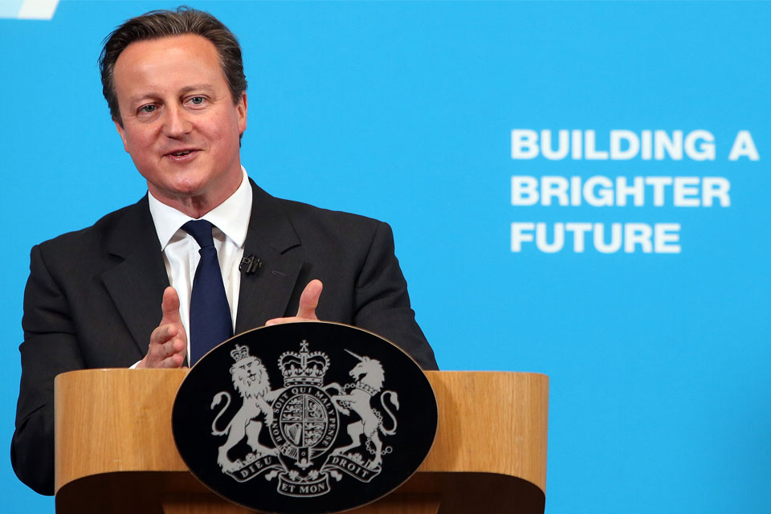

Slide 5
Unintended consequences
Studies suggest that the expansion of higher education has predominantly benefited the (not so bright) children of the middle-classes (see for example : Marginson, 2016; Shiner and Noden, 2014).

Slide 6
Access to ‘Top Jobs’
https://www.suttontrust.com/wp-content/uploads/2014/01/pathwaystobankingreport-24-jan-2014.pdf

Slide 7
Higher Education
Institution | Total full-time first degree entrants | Number from manual occupational back- grounds | % from manual occupational back- grounds*
The University of Oxford | 2,875 | 275 | 11.5
The University of Cambridge | 2,930 | 315 | 12.6
The University of Bristol | 3,140 | 375 | 14.2
University of Durham | 3,195 | 445 | 16.8
The University of Edinburgh | 3,770 | 550 | 18.6
Imperial College of Science, Technology and Medicine | 1,490 | 205 | 18.7
London School of Economics and Political Science | 715 | 115 | 18.7
The University of Bath | 1,895 | 290 | 19.0
The University of Warwick | 2,815 | 415 | 19.0
The University of Nottingham | 5,280 | 790 | 19.1

Slide 8
Higher Education
Institution | Total full-time first degree entrants | Number from manual occupational backgrounds | % from manual occupational backgrounds*
University College Plymouth St Mark and St John | 650 | 160 | 50.6
The University of Bolton | 1,130 | 185 | 52.3
The University of Bradford | 2,055 | 525 | 52.4
The University of Wolverhampton | 3,285 | 750 | 53.1
Glyndŵr University | 760 | 80 | 54.5
The University of Greenwich | 3,805 | 855 | 55.5
London Metropolitan University | 3,915 | 705 | 57.2
‘Financial strictures, the need to work in the labour market, anxieties about the strangeness and unfamiliarity of higher education, linked to fears around fitting in, all add up to a very different, and more stressful experience of higher education choice.’
(Reay, D., David, M. E., & Ball, S. J. (2005). Degrees of choice: Class, race, gender and higher education. Trentham Books.)

Slide 9
Higher Education

Slide 10
Systematic (dis)advantages depending on background
Attraction
Relationship between elite employers and HEI
Pre-Screening
Socio-economic background and attainment.
Psychometrics
Coachable?
Interviews and Assessment Days
‘Polish’ alongside (or instead of) potential.
Performance
and Progression
Extends into opportunities for progression.

Slide 11
Progress in Practice and Policy
Demand-Side
Supply-Side
Bias Training
Alternative Entry Routes / Target Universities
Skills Training
Flexible Screening on Credentials
Mentoring
CV Blind Interview Techniques
Internships
Contextual Data in Recruitment
Outreach Programmes in Schools

Slide 12
Measurement and Data
The % of employers that are monitoring diversity indicators and have active strategies to address them
Source: Association of Graduate Recruiters 2015

Slide 13
‘Class Ceiling’
The socially mobile (of any range) in finance have predicted earnings of £11,200 less per year than otherwise similar privileged colleagues, in media £9,440, law £8,830 and in medicine £5,050.
This disadvantage also tends to increase the longer the range of mobility. In law, for example, the long-range upwardly mobile face a huge estimated annual pay gap of £19,700.
Laurison, D., & Friedman, S. (2016). The class pay gap in higher professional and managerial occupations. American Sociological Review, 81(4), 668-695.

Slide 14
(Why) does it matter?

